Slide 1
Relational Algebra (Part-6)
20.5

Slide 2
Contents
Intersection

Slide 3
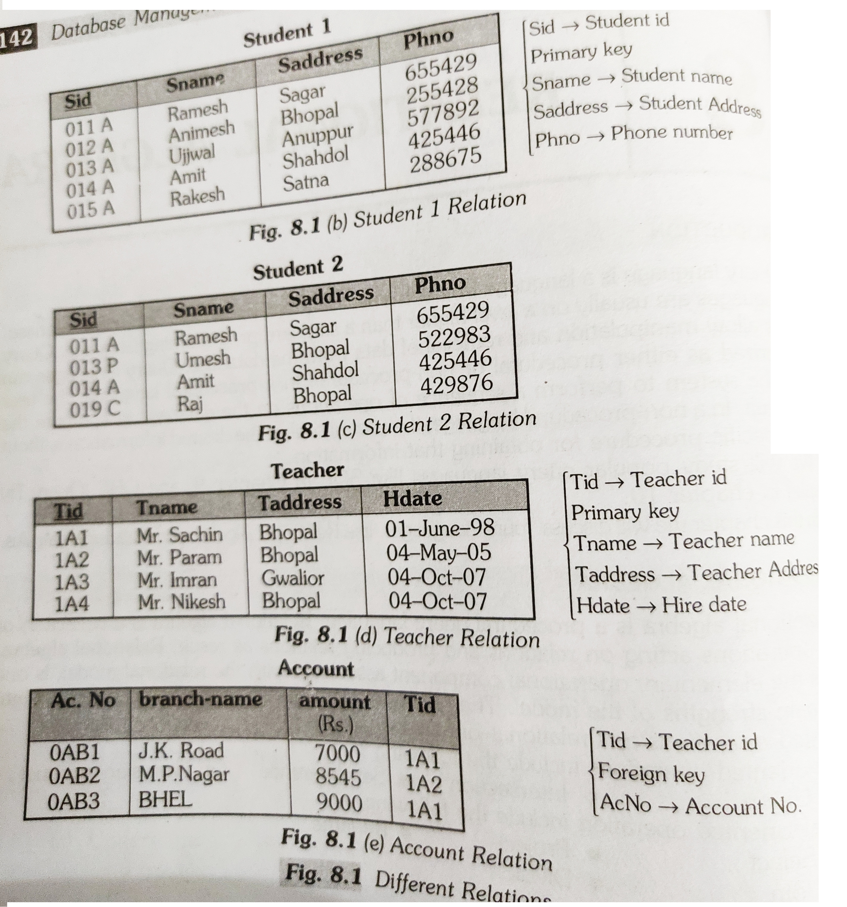
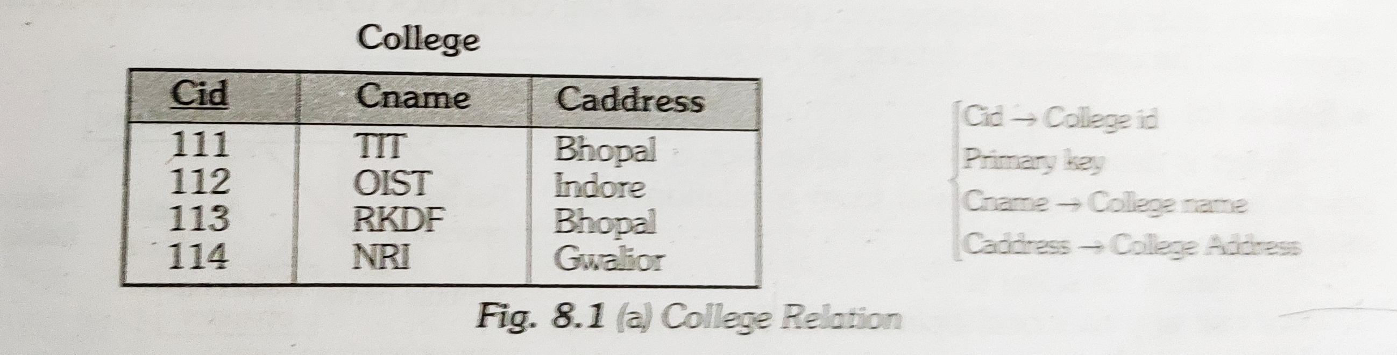
Intersection

Slide 4
Intersection
Intersection (∩)
Intersection on two relations R1 and R2 can only be computed if R1 and R2 are union compatible (Already studied in Union Lecture) (These two relation should have same number of attributes and corresponding attributes in two relations have same domain).
Intersection operator when applied on two relations as R1∩R2 will give a relation with tuples which are in R1 as well as R2.

Slide 5
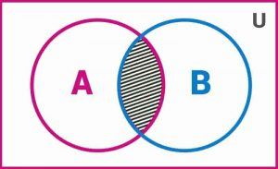
Intersection
Syntax:
Relation1 ∩ Relation2
A intersection B is given by: A ∩ B = {x : x ∈ A and x ∈ B}.
This represents the common elements between set A and B

Slide 6
Intersection

Slide 7


